Slide 1

Crafting Spaces That Define Modern Living
Residential Interior Services Catalog
Comprehensive Solutions for Residential Spaces
Quality | Customization | Excellence

Slide 2
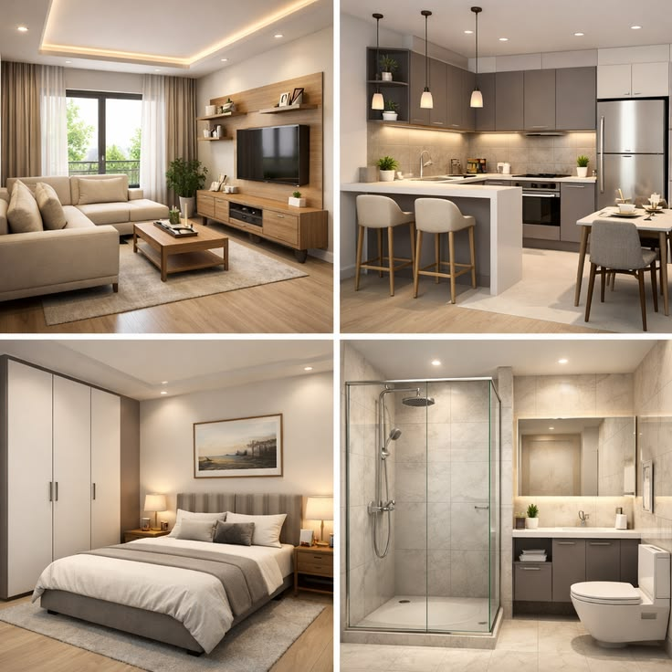
01
Modular Furniture
Customized modular furniture solutions designed to enhance comfort, functionality, and space utilization in your home with modern designs and premium finishes.
✔ Modular Kitchen Design & Installation
✔ Wardrobe Design & Manufacturing
✔ TV Unit & Entertainment Unit Solutions
✔ Modular Bedroom Furniture
✔ Living Room Storage & Display Units
✔ Study Table & Home Office Furniture
✔ Shoe Rack & Utility Storage Solutions
✔ Crockery Unit & Dining Area Furniture
✔ Complete Residential Modular Furniture Solutions

Slide 3
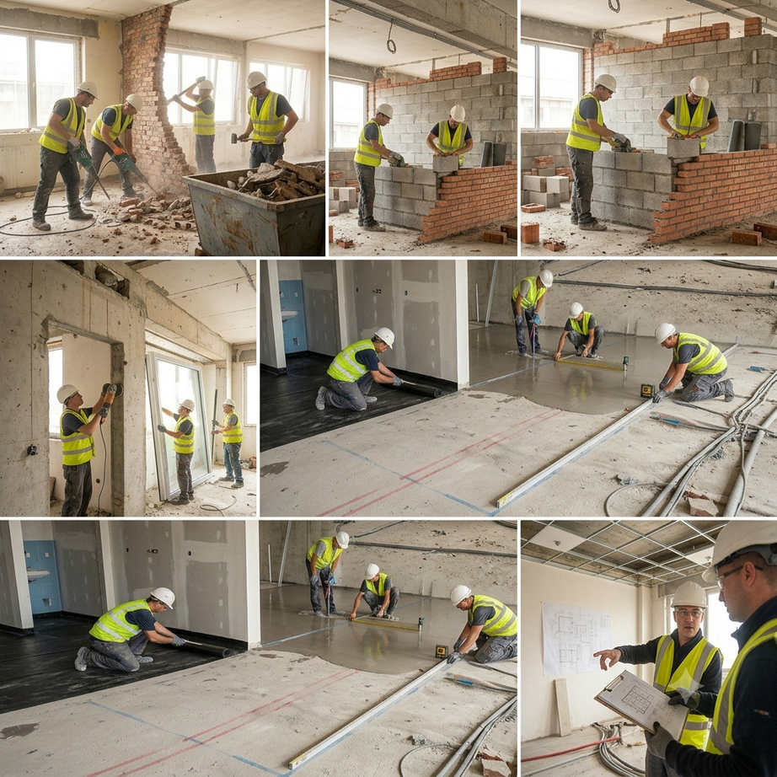
02
Civil Modification Work
Structural changes to transform your space layout, ensuring safety and compliance with building standards.
✔ Wall demolition & removal
✔ New wall construction (brick/block/drywall)
✔ Door & window opening modifications
✔ Waterproofing & damp-proofing
✔ Floor leveling & corrections
✔ Beam & column reinforcement
✔ Partition wall installation

Slide 4
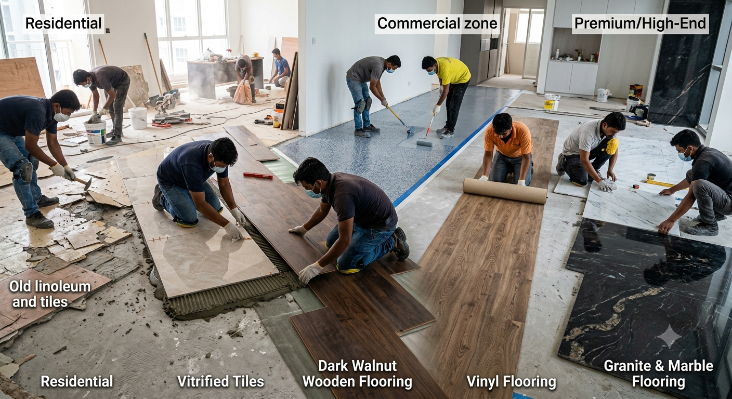
03
Flooring
Complete flooring solutions from removal of old surfaces to installation of premium materials tailored to your space.
✔ Old flooring removal & surface prep
✔ Vitrified tile installation
✔ Wooden & laminate flooring
✔ Vinyl & SPC flooring
✔ Epoxy flooring for industrial spaces
✔ Granite & marble flooring
✔ Floor polishing & restoration

Slide 5
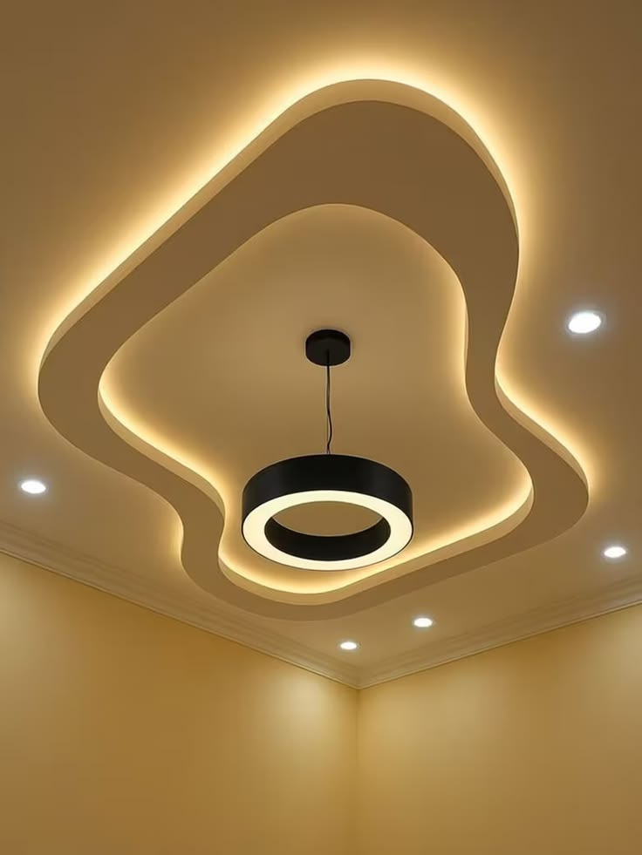
04
False Ceiling Installation
Aesthetic and functional ceiling solutions that enhance your space with modern designs, lighting integration, and acoustic control.
✔ Gypsum board false ceilings
✔ POP (Plaster of Paris) ceilings
✔ Modular grid ceiling systems
✔ Wooden & PVC ceiling panels
✔ Cove lighting integration
✔ Multi-level designer ceilings
✔ Acoustic ceiling solutions

Slide 6
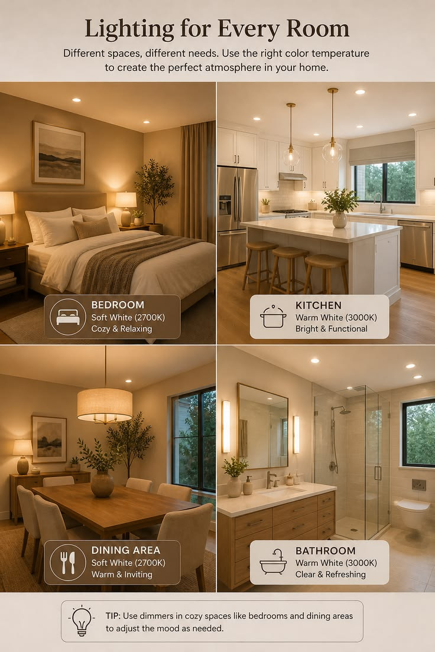
05
Electrical
Complete electrical upgrades ensuring safety, efficiency, and modern convenience with quality fixtures and certified workmanship.
✔ Complete rewiring & cabling
✔ DB box installation & upgrades
✔ Modular switches & sockets
✔ LED lighting design & installation
✔ Electrical safety inspection
✔ Earthing & surge protection
✔ Smart automation wiring

Slide 7
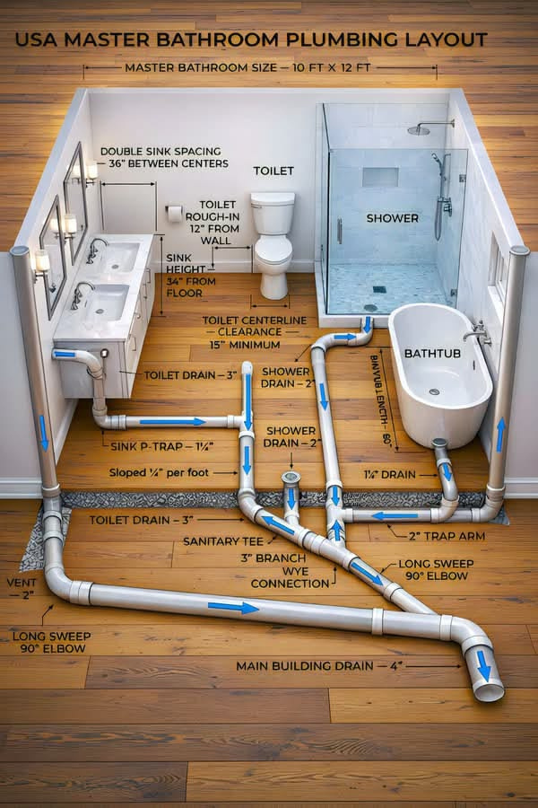
06
Plumbing
Reliable plumbing solutions covering water supply, drainage, and fixture installation for kitchens, bathrooms, and commercial spaces.
✔ Water supply line installation
✔ Drainage & sewage systems
✔ Bathroom & kitchen plumbing
✔ Sanitary fixture installation
✔ Leak detection & repair
✔ Water heater & purifier setup
✔ Pipe replacement & upgrades

Slide 8
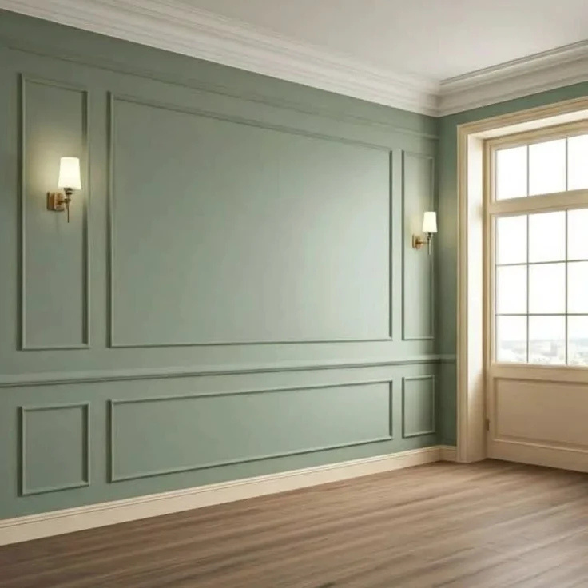
07
Painting & Wall Finishes
Transform your walls with premium paints, textures, and decorative finishes that elevate the look and feel of any interior or exterior.
✔ Interior & exterior painting
✔ Texture & stucco finishes
✔ Wallpaper installation
✔ Decorative wall treatments
✔ Wood & metal surface painting
✔ Waterproof & anti-fungal coatings
✔ Color consultation & matching

Slide 9
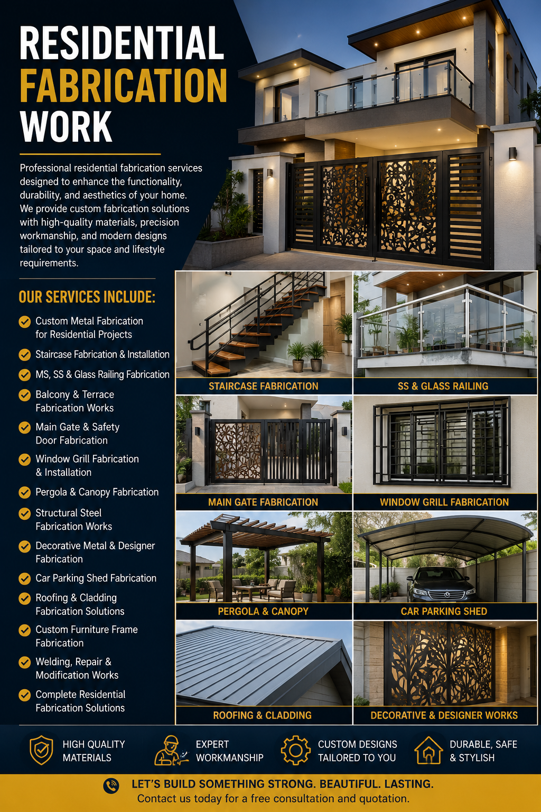
08
Fabrication Work
Professional residential fabrication services designed to enhance the functionality, durability, and aesthetics of your home. We provide custom fabrication solutions with high-quality materials, precision workmanship, and modern designs tailored to your space and lifestyle requirements.
✔ Complete Residential Fabrication Solutions
✔ MS, SS & Glass Railing Fabrication
✔ Balcony & Terrace Fabrication Works
✔ Main Gate & Safety Door Fabrication
✔ Window Grill Fabrication & Installation
✔ Pergola & Canopy Fabrication
✔ Structural Steel Fabrication Works
✔ Decorative Metal & Designer Fabrication
✔ Roofing & Cladding Fabrication Solutions

Slide 10
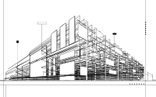



Crafting Spaces That Define Modern Living
Comprehensive Solutions for Residential Spaces
KPS projects and interior pvt. ltd.
Address
Contact
Office no. 228, Blue sapphire Bussiness park, Wakad-Bhosari Rd, Pimple Saudagar, Maharashtra 411027
www.spacekraaftbykps.com
+91 76665 44822

